Slide 1


Sap ABAP on Hana &
s/4hana trainings
Anubhav Oberoy

Slide 2

INTRODUCTION

Slide 3
Agenda – Day 8
CDS Table Functions
CDS-BOPF Integration
Describing Validation in ( Business Object ) BO
Implementation of Smart filter UX Application
Transactional UX App with CDS and BOPF
--Break--
Hierarchy CDS Programming with Tree Table
New Hierarchy
Classical Hierarchy
Implementation of End to End Hierarchy Scenario of Employee Manager Hierarchy
Describing Functional Information of Hierarchy

Slide 4
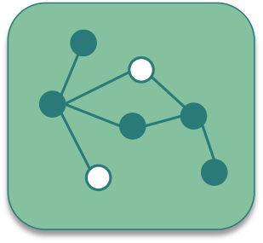
CDS Table Function
CDS Table Functions allow to use natively implemented database-functions in SAP HANA DB directly from CDS

Slide 5
Why we need CDS Table Function
CDS is an open extension of classical DDIC views:
Support for AnyDB
Optimal integration into DDIC and ABAP
Supports about 90 % of SQL features
But: no access to specific HANA features
Required: Some scenarios require selective measure (“Breakout Scenario” for HANA-only applications)
Highest performance requirements e.g. with complex calculations
Use of database / analytical engine specific functions required
Open SQL and CDS views do not yet offer functionality to solve the problem

Slide 6
Necessary part of CDS Table Function
Table function definition
Parameter list
Return Parameter
Reference to implementing method
Runtime for table function
Runs stored SQL-script procedure generated from AMDP on database tables
ABAP Managed Database Procedure
SAP HANA Database
DDL Source
AMDP Implementation
Includes SQL-script function body
Notes:
The sole purpose of an R/3 system is to provide a suite of tightly integrated, large-scale business applications. R/3 comes prepackaged with the core business applications needed by most large corporations. These applications coexist in one homogenous environment. They are designed from the ground up to run using a single database and one (very large) set of tables.
Presentation: It is usually installed on a user's workstation. When started, the presentation server displays the R/3 menus within a window. This window is commonly known as the SAPGUI, or the user interface (or simply, the interface).
Basis : Basis is like an operating system for R/3. It sits between the ABAP/4 code and the computer's operating system. SAP likes to call it middleware because it sits in the middle, between ABAP/4 and the operating system. ABAP/4 cannot run directly on an operating system. It requires a set of programs (collectively called Basis) to load, interpret, and buffer its input and output. Basis provides the runtime environment for ABAP/4 programs.
Database: The database server is a set of executables that accept database requests from the application server. These requests are passed on to the RDBMS (Relation Database Management System). The RDBMS sends the data back to the database server, which then passes the information back to the application server. The application server in turn passes that information to your ABAP/4 program.

Slide 7
Key Feature of Table Function
They are implemented in HANA SQLScript via AMDP methods
Signature is defined in DDL source (importing parameters and return columns)
They can be consumed by Open SQL and ABAP CDS like other DDIC artifacts (i.e. DB tables, classical DDIC views, CDS views ...)
The SQLScript implementation is handled by the AMDP framework (lifecycle, tool support, extensibility etc.)
DDL source can be activated before the implementing AMDP method exists

Slide 8

CDS BOPF
The Business Object Processing Framework is an ABAP OO-based framework that provides a set of generic services and functionalities to speed up, standardize, and modularize your development. BOPF manages the entire life cycle of your business objects and covers all aspects of your business application development.

Slide 9
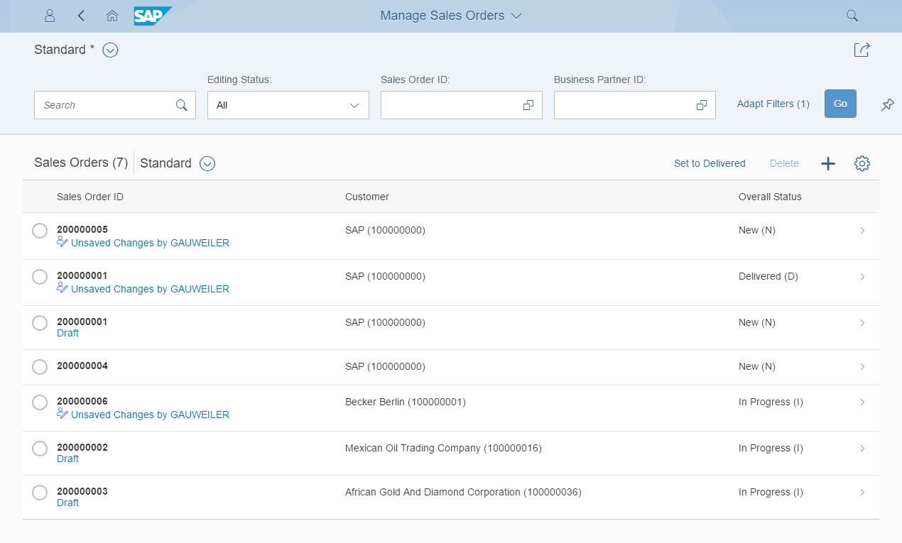
Development flow & Artifacts
consume
SAP Fiori Elements, …
OData Service
Consumption view
Consumption view
Search Object(s)
Core Data Services
generate / publish
Subnode consumption view
Subnode consumption view
Subnode consumption view
Subnode consumption view
Metadata Extension
enrich
Data Definition
generate
BOPF Business Object
implement
Custom ABAP Business Logic
Draft table
Draft table
Database table
Draft table

Slide 10
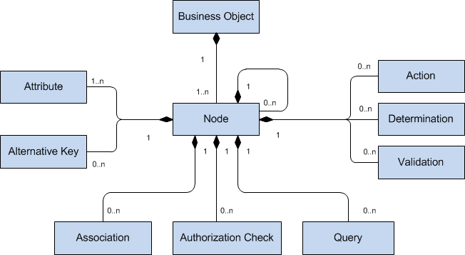
Business Object
The business objects are the basic units of the BOPF-based programming model. Business applications or processes operate on certain business objects. A business object is represented as a hierarchical tree of nodes. A single node includes a set of semantically related business object data and the corresponding business logic. On the technical level, each node is implemented with a regular Dictionary table, where each node instance corresponds to a single table entry (table rows). Nodes, attributes, and alternative keys set up the data part of a business object. Again from a technical viewpoint, attributes form the columns of the table. A node serves as an anchor point for connecting the business logic of the business object.

Slide 11
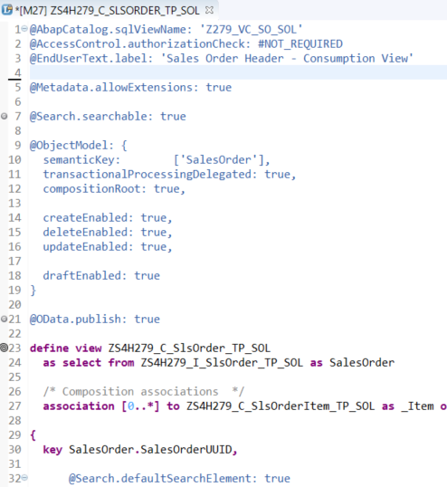
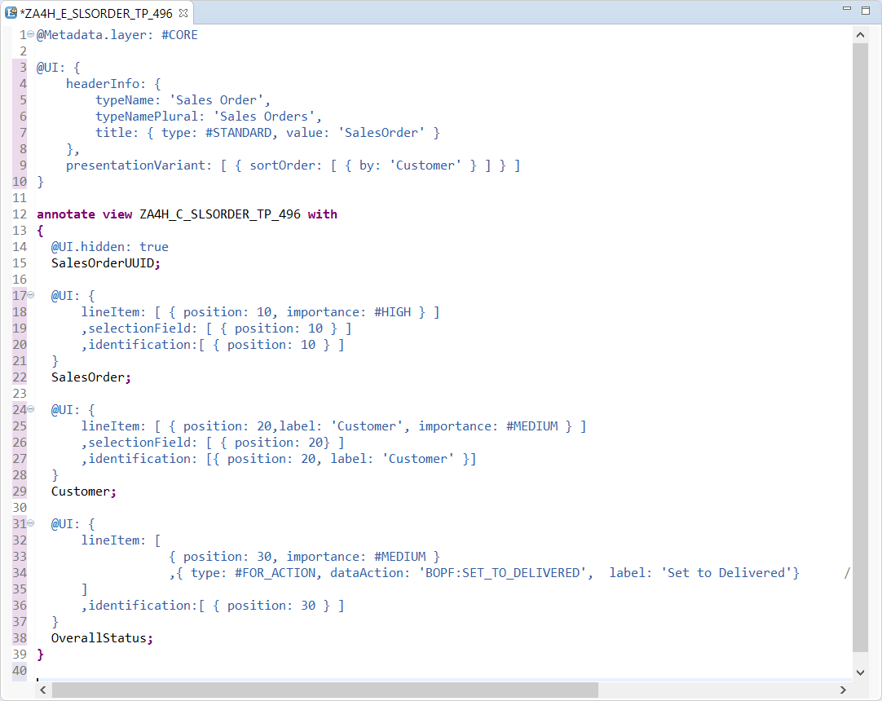
Transactional UX App with CDS & BOPF
With Draft Functionality
Access Control
UI semantic
Search enablement
Transactional enablement
OData exposure

Slide 12

Break

Slide 13
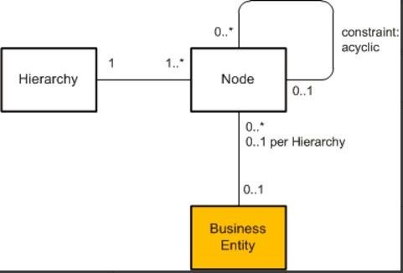
CDS Hierarchy
The CDS view provides a list of hierarchies which is known the hierarchy directory for this node view. Every single node belongs to exactly one hierarchy, which can identified by one or multiple key fields of the node view.
A hierarchy can have multiple root nodes.
Hierarchies allows to traverse data faster
They clearly explain the inter-relation between multiple object
Very helpful determining the parent child relationship

Slide 14
Types of Hierarchy
There are Two types of Hierarchy
Creating Using Annotations
Creating by syntax
CDS Hierarchy
New Hierarchy
Classical Hierarchy

Slide 15

End to End Hierarchy Scenario

Slide 16
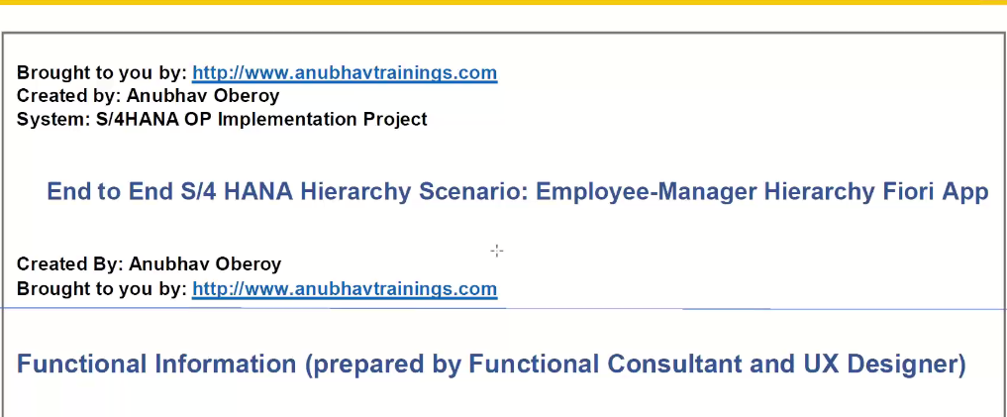
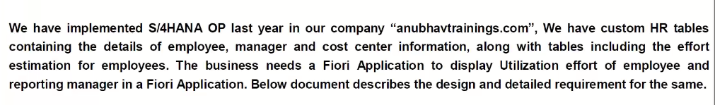
Elaborating Scenario

Slide 17
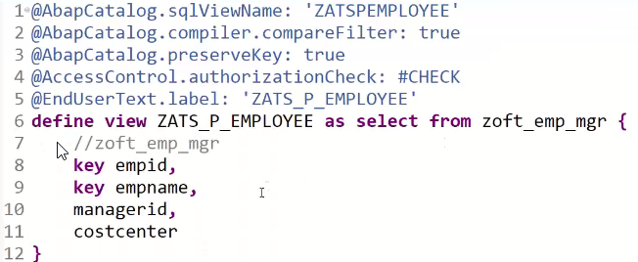
Creating Resource CDS

Slide 18
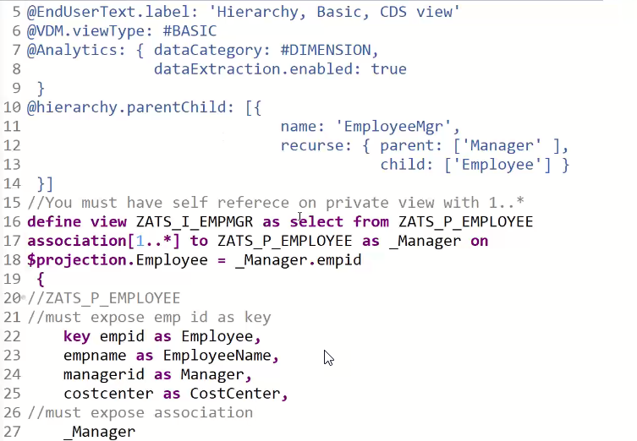
Creating Basic CDS View

Slide 19
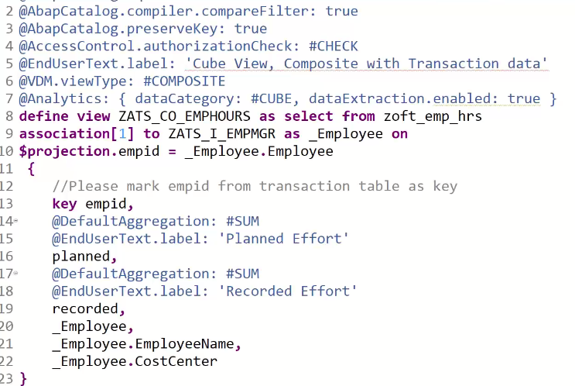
Composite CDS View

Slide 20
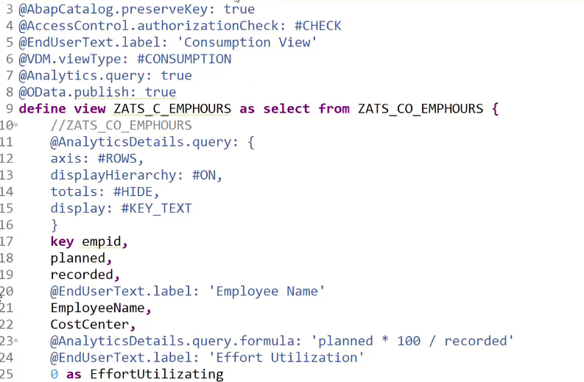
Consumption CDS View

Slide 21
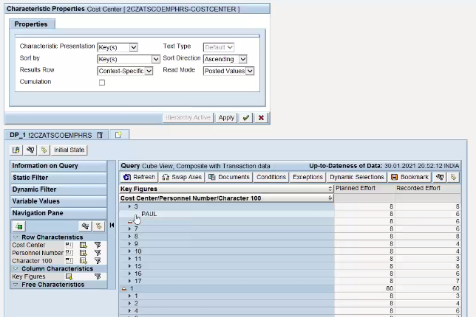
Check Hierarchy on Query Brower

Slide 22
Feedback
AnubhavTrainings.com :
https://www.anubhavtrainings.com

Slide 23
End of Day 8

Slide 24

Questions

Slide 25

Anubhav Oberoy

